Slide 1
CS3733 Wong
Requirements: User Stories

Slide 2
Agile Functional Model
User’s point of view of what the system can do for the user
Epics
User stories
Card
description of functionality
Conversation
details of functionality
Confirmation
verification and user approval of functionality
Storyboards
UI Mockups/Prototypes
Scenarios
User story sizing

Slide 3
Epics
Description of requirements at the feature level or higher
High-level decomposition / description of the system
Systems requirements
The major activities or tasks that need to be done to create the system’s functionality
User stories are grouped under epics
Readings on user stories and epics
Rubin Ch. 5
https://www.atlassian.com/agile/delivery-vehicles

Slide 4
User Stories
User story (card)
A sentence or two in everyday language that captures what an end-user does or needs to do
Includes who, what, and why
For simple systems
You should be able to list all user stories on a single page
Formal version of a user story:
As a [Role], I want [Feature] so that [Reason/Benefit]

Slide 5
User Story Refinements
Read (includes examples): https://www.visual-paradigm.com/learning/handbooks/agile-handbook/user-story.jsp
Card
a description of user functionality
Use Trello or Git Hub. In the past, often written on a post-it note.
Conversation (ignore the Rubin textbook on this subject!)
Detailed description of how does the functionality works
Gathered through communications (conversations) with the users
Include conditions of satisfaction
UI mockups / application wireframes, scenarios, storyboards and parts of use cases may be useful
Confirmation
Details are confirmed by the users
Acceptance tests
Acceptance criteria can include models and user interface examples

Slide 6
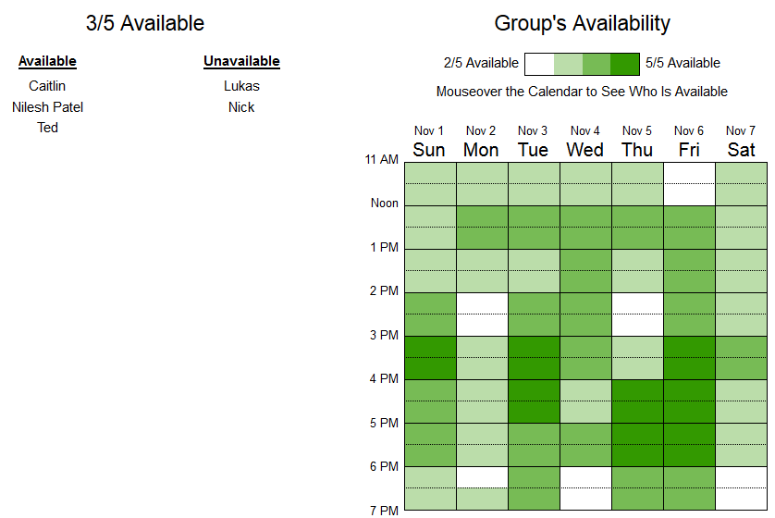
Example: When2Meet
Meeting calendar example

Slide 7
When2Meet User Stories
Epic 1: Meetings
As a MeetingCreator, I want to [Create meeting] so [group can select convenient time]
As a MeetingCreator, I want to [View meeting] so [I can determine best time]
As a MeetingParticipant, I want to [Select meeting times I can make] so [everyone knows]
As a MeetingParticipant, I want to [Unselect meeting times I can’t make] so [everyone knows]
Epic 2: Login
As a MeetingParticipant, I want to [Sign in] so [I can participate]
Epic 3: Admin
As a MeetingAdministrator, I want to [Delete unused meetings] so [sufficient space remains]

Slide 8
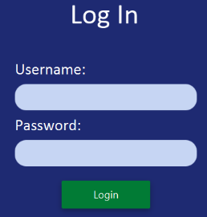
When2Meet Conversation
User Story Card
As a MeetingParticipant, I want to [Sign in] so [I can participate]
User Story Conversation
A Username and accompanying password has already been created for the user
User enters a user name in the first input box
User enters a password in the second input box
User either hits the [Enter] key or clicks on the Login button to login
If user name does not exist or the password does not match the user name, then an error message “Incorrect login: please check your login name or password and try again”
If the user name and password input boxes are both blank, and the user either hits the [Enter] key or clicks on the Login button, nothing happens

Slide 9
User Story Confirmation
Able to login
by either pressing the [Enter] key or clicking on the Login button when a valid user name with its associated password is entered
testuser with password 1234 works
Error messages are displayed when
a non-existent user name is entered
a password that does not match the one on record associated with the user name is entered
a user name that contains non-alphabetic characters is entered

Slide 10
User Story Sizing
User stories are prioritized and placed in a product backlog (use GitHub Issues / Trello)
Higher priority items which will be implemented in the next iteration or two are broken up into smaller user stories and precisely sized using Planning Poker
Lower priority items are left as larger user stories and roughly sized using T-Shirt Sizing
The bottom priority items may be as large as epics to be done in the future

Slide 11
T-Shirt Sizing
The team estimates the effort of implementing a user story in one of the following categories:
Extra small
Small
Medium
Large
Extra large
These sizes are fine for the middle to the bottom of the product backlog
The top of the product backlog needs metrics in the form of relative user story points. Use planning poker to determine these!

Slide 12
Planning Poker
Entire team has to participate. Scrum master coordinates.
Using a regular decks of cards, for each person, create hands of the following values: 0, 1, 2, 3, 5, 8, 13, and 21 For 0 and 21, designate a face card or joker.
As each story is read by the product owner and discussed by the team, sizes and numbers should not be mentioned
Each person selects a card representing the effort for the team to implement it. Timer can be used to end long discussions.
Team members with lowest and highest votes explain to the team why they chose those values.
Repeat until there is consensus
Note: the values should be relative to one another. For example, a value of 8 indicates it would take 4 times as much effort as a value of 2.

Slide 13
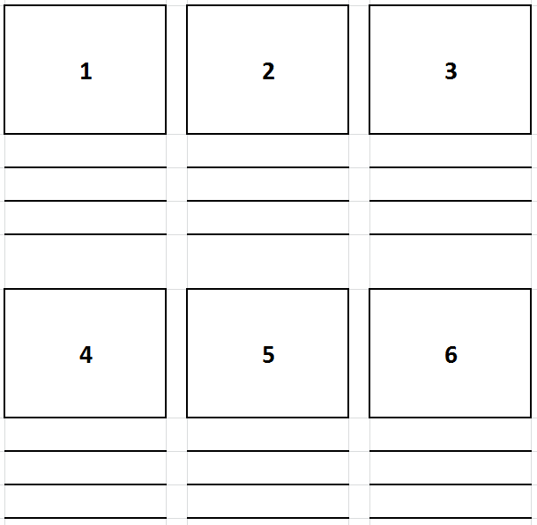
Storyboard Template
Tells a story of how the user interacts with the system to achieve a goal
Sequential images
Additional description below if needed

Slide 14
Scenarios
Scenario
A textual description of the usage of a system. The description is written from an end user’s point of view.
A synthetic description of an event or series of actions and events.
A scenario can include text, pictures, storyboards and video. It usually also contains details about the work place, social situations and resource constraints.
Typically includes multiple users and their interactions, and thus multiple user stories.
Notes:
http://www.island-resort.com/scenario.html
Central to most scenario based design is a textual description or narrative of a use episode. This description is called a scenario.
The scenario is described from the user point of view and may include social background, resource (e.g. disk space, time) constraints and background information. The scenario may describe a currently occuring use, or a potential use that is being designed and may include text, video, pictures, story boards, etc.By using a narrative it is possible to capture more information about the user's goals, and the context the user is operating in. The context might include details about the work place or social situation, and information about resource constraints. This provides some more help in understanding why users do what they do. In much current design work the users goals and context are often assumed implicitly, or may not be taken into account.The scenario then becomes the design object or artifact and may be augmented and rearranged as the design evolves. It can become a hypothetical interaction scenario for a new design and allow better understanding of the new design. It is also desirable to maintain a history of past scenarios as a way of capturing past design rationale.In one sense scenarios are not really new in design activity. It's extremely common in design to imagine "what if" situations, or to walk through a design in ones mind or in a group. Scenario based design is an effort to make some of what we do already more conscious and explicit.

Slide 15
Scenario-based Design
Focuses on concrete descriptions and particular instances, not abstract generic ideas
Uses proper nouns and describes specific situations
It is work driven not technology driven
It is open-ended, it does not try to be complete
It is informal, not formal and rigorous
Typically need multiple scenarios to cover different instances of using a system feature

Slide 16
Scenario example: Warehouse on Fire
Public Emergency System
Bob, driving down main street in his police patrol car notices smoke coming out of a warehouse. His partner, Alice, reports the emergency from her car.
Alice enters the address of the building into her wearable computer , a brief description of its location (i.e., north west corner), and an emergency level.
She confirms her input and waits for an acknowledgment.
John, the dispatcher, is alerted to the emergency by a beep of his workstation. He reviews the information submitted by Alice and acknowledges the report. He allocates a fire unit and sends the estimated arrival time (ETA) to Alice.
Alice received the acknowledgment and the ETA.

Slide 17
Scenario Observations
Concrete scenario
Describes a single instance of reporting a fire incident.
Does not describe all possible situations in which a fire can be reported.
Participating users/actors
Bob, Alice and John
Interactions
Between users/actors with different components of the system
Notes:
What type?
As-is, visionary, evaluation, training?

Slide 18
Exercise
You need to create an innovative Boston Freedom Trail mobile app that will include a gaming component. Create the following
Epics
User Stories
UI mockup
A storyboard
A textual scenario
Use steps 3 to 5 to create the user story conversations
Create the user story confirmations

